Slide 1
Autism & Mental Health:
A Brief Overview
Todd Kopelman, Kelly Pelzel, & Peter Daniolos
The University of Iowa Children’s Autism Center

Slide 2
Outline
Prevalence of ASD & Mental Health Issues
Therapeutic Interventions
Psychopharmacological Treatments

Slide 3
ASD: Overlapping Symptoms
Social
Communication
ASD
RRB
Based on Kaufman, W. (2012): The New Diagnostic Criteria for Autism Spectrum Disorders

Slide 4
ASD: Overlapping Symptoms
Anxiety/
Depression/OCD
GI Disorder
Seizures
Feeding Difficulties
Sleep Difficulties
Motor Difficulties
Social
Communication
ADHD
Social
Aggression
ASD
Self-injury
Language
Disorder
Commun
RRB
ID
Based on Kaufman, W. (2012): The New Diagnostic Criteria for Autism Spectrum Disorders
Notes:
Oftentimes the profile is more complex

Slide 5
ASD & Mental Health
Not well understood! Why?
1. DSM-IV & co-diagnoses (ADHD, OCD, SA)
2. Mismatch between criteria & ASD reality
3. Lack of awareness, training, certainty

Slide 6
ASD & Mental Health
4. Diagnostic Overshadowing
Falsely attributing symptoms to ASD
Health care providers OVERLOOK psychiatric co-morbidity
Can result in poorer outcomes
“She’s can’t focus at school because she has
ASD… He paces all the time because that’s what people with autism do… He hits himself in the face because he has autism”

Slide 7
Benefits of Awareness
1.  understanding by caregivers, school teams, & providers
2. Focused research and treatment
Are there different genetic identifiers?
Do children with ASD & ADHD require different social supports than children with ASD w/o ADHD?
3. Improved quality of life!

Slide 8
Prevalence of MH Issues in ASD
~ 70% of individuals with ASD meet criteria for at least one MH disorder
~ 41% have two or more MH disorders
~ 17% two disorders, 24% three disorders
Persons with ASD 2x as likely to have MH disorder compared to those with ID

Slide 9
Autism & ADHD
www.health.com

Slide 10
Autism & ADHD
May be most common co-occurring disorder among children with ASD
Estimates range 28%-50%
Nearly 85% of individuals with comorbid ASD/ADHD met criteria for an additional disorder

Slide 11
Autism & ADHD
All symptoms may be observed in a similar manner in persons with only ADHD (hyperactive/impulsive, inattentive, combined subtypes)
Children with ASD more likely to exhibit inattentive subtype
Cause of inattentiveness may differ (overfocus on strong interest)

Slide 12
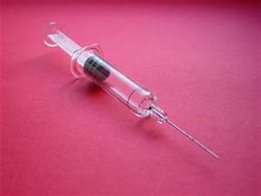
Autism & Anxiety
http://en.wikipedia.org/wiki/2007_Elie,_Manitoba_tornado
http://www.bing.com/images/search?q=needles&FORM=HDRSC2#view=detail&id=C731106E5F649501C98E0AA9EF29F65AA453CD42&selectedIndex=0

Slide 13
Autism & Anxiety
Approximately 40% meet DSM criteria
Specific phobia or fear (44%) – (needles, crowds, storms, loud noises)
Social anxiety – fear of being negatively evaluated in social situations, fear of new people and situations (29%)
Generalized anxiety – persistent worrying/anxiety (13%)
Panic Disorder – panic attacks (10%)
Notes:
Obsessive compulsive disorder – 8-33%; 85% display compulsions. Common compulsions include having others do things or say things a certain way

Slide 14
Autism & Anxiety
Avoidance of the source of anxiety or extreme distress
Symptoms can be physical (muscle tension, shortness of breath), cognitive (worrying, restlessness), or behavioral (agitation, crying)
Signs of anxiety for persons with ASD: Avoidance of new people, increased performance of rituals, increased reliance on scripts, seeking constant reassurance, self-soothing & repetitive behaviors

Slide 15
Autism & Anxiety
Rates may increase in adolescence (
awareness of differences?)
Can be challenging to diagnose due to communication difficulties

Slide 16
Autism & Depression
www.babble.com

Slide 17
Autism & Depression
10% of children with ASD had at least 1 episode of MDD
Rates seem to increase in adolescence and adulthood (25-30%)
Can be tricky to diagnose for individuals with ASD & ID

Slide 18
Autism & Depression
Common indicators:
Increase in rate of challenging behaviors
Increased tearfulness/irritability
Loss of interest/resistance to participating in activities/neglecting hygiene
Agitation or restlessness; sleep difficulties
Increased stereotyped behaviors

Slide 19
Risk Factors for Comorbid MH Disorder
1. Associated medical conditions (Fragile X)
2. Familial history of MH diagnoses
3. Psychosocial factors (e.g., social isolation, lack of supportive environment)

Slide 20
Take Home Points
Diagnosis can be challenging
Persons with ASD are not immune to MH issues
Avoid diagnostic overshadowing
Be aware of significant changes (Affect, personality, behaviors, productivity, personality)
Consider if symptoms interfere with functioning
Don’t be afraid to pursue evaluation & treatment

Slide 21
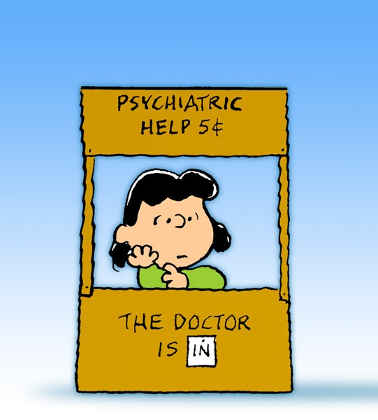
Therapies for Co-Occurring Mental Health Disorders

Slide 22
Proactive Measures
Identify risk & protective factors
If possible, reduce risk & enhance protective
Support prevention efforts
Physical health
Coping skills (e.g., relaxation techniques)
Make a plan for what to do when problems occur
Make & maintain community relationships
Crisis plan (e.g., elopement)

Slide 23
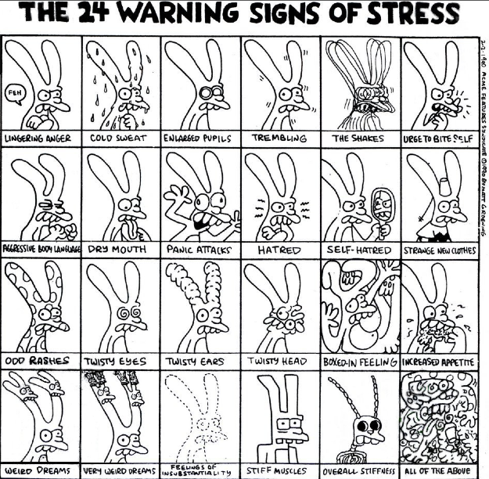

Slide 24
General Thoughts on Therapies
Less research on how well therapies (especially psychotherapies) work with people with autism (compared to research on people without autism).
Harder to study (lower base rate)
Area avoided historically (i.e., during heydays of psychotherapy research)
Recently, cognitive behavioral therapy (CBT) has been studied more.

Slide 25
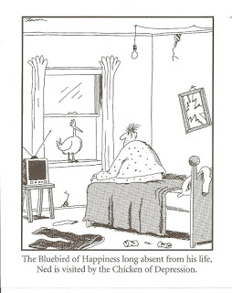

Slide 26
Types of Therapies
Behavior Therapies – often target behavioral disorders (e.g., aggression, non-compliance, self-injury)
Psychotherapies – often target mood and anxiety disorders (e.g., depression, phobias)
Nowadays most therapies for children include some degree of parent involvement.

Slide 27
Behavior Therapies
There are many types of Applied Behavior Analysis (ABA), and some types address behavior problems.
Examples: Functional Communication Training (FCT) and Antecedent-Based Interventions
Research: tends to be more data collected on a few people.
Disadvantage: Requires more time for assessment.
Other behavior therapies traditionally come from a parent training (PT) approach.
Examples: Parent Child Interaction Therapy (PCIT), RUPP studies (Aman et al.)
Research: tends to be fewer data collected on a lot of people.
Disadvantage: More like a cookie cutter.

Slide 28
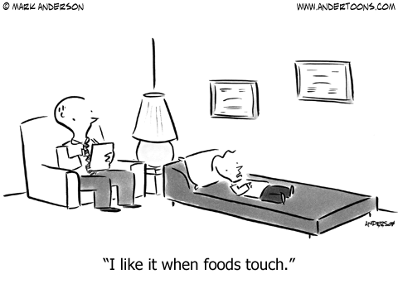

Slide 29
Psychotherapies
Cognitive Behavioral Therapy
Identifying relationship between thoughts, behaviors, & emotions; replacing dysfunctional with more functional.
Also sometimes process effect on others’ thoughts, behaviors, & emotions.
Examples: Self-management (for depression), Exposure/Response Prevention (E/RP; for anxiety)
Many CBT approaches for children use visual supports (e.g., 5-point scale materials)
Weak evidence for insight-oriented therapies & individual play therapy (i.e., psychoanalytic approaches).

Slide 30
Autism Spectrum Disorders & Medications Psychopharmacology: Evidence, Indications & Limitations
Peter Daniolos, MD

Slide 31
Psychopharmacology Interventions
Need diagnostic clarity as AS dx & cognitive level impact sensitivity and response to medications
Co-morbidity impacts medication selection
NO AGENT HAS BEEN DEVELOPED THAT DIRECTLY TARGETS OR IMPROVES CORE AUTISM FEATURES: SOCIAL OR COMMUNICATION DEFICITS
Meds target interfering symptoms
ASD youth sensitive to side effect….low/slow dosing key!!!!
Psychosocial interventions always come first!!!!

Slide 32
Treatment Targets: medications
Motor hyperactivity/inattention
Aggression
SIB
Tantrums
Irritability/ agitation
Ritualistic/ repetitive behaviors
Stereotypies
Comorbid anxiety/ OC symptoms
Depression

Slide 33
Rationale for early medications [Bethea and Sikich Biol psych 2007; 61:521-537]
ASD youth often have associated behavior problems- impacts development.
Altered brain morphology in autism (Kemper and Bauman- cerebellum, etc)- target with medications?
May regulate neurodevelopmental processes and increase plasticity
Manipulating serotinergic system with SSRI may assist experience dependent brain organization.
May enhance child’s ability to respond to behavioral treatments

Slide 34
5HT & SSRI’s: Kanner
Kanner 43: focused on repetitive nature of behavior, speech and modes of interactions as core elements of autism.
Verbal and motor rituals, obsessive questioning, and rigid adherence to routine.
Preoccupation with details and obsessive desire for the maintenance of sameness and completeness
Implies abnormalities in 5HT function, and therefore a potential role for SSRI’s
Pubertal differences? Less tolerated/effective in younger kids?

Slide 35
SSRI: Prozac & repetitive behaviors
One of the most rigorous study to date looked at Prozac and repetitive behaviors in ASD youth
8 wk double blind placebo controlled crossover Prozac study noted decreased repetitive behaviors on C-YBOCS, but not global improvement in core autism symptoms. N=45, Dose 2.4 – 20mg, with a mean final dose of 9.9 +/- 4.35 mg/day.
Primary side effect: agitation
Hollander et al 2005 Neuropsychopharmacology 30:582-89

Slide 36
ASD Adults: Prozac
Hollander, Anagnostou et al 2008 Study (Am J Psychiatry v169 #3, March ‘12): Fluoxetine treatment, compared to placebo, resulted in significantly greater improvement in repetitive behaviors, according to both the Yale-Brown compulsion subscale and CGI rating of obsessive-compulsive symptoms, as well as on the CGI overall improvement rating. Fluoxetine appeared to be well tolerated. These findings stand in contrast to findings in a trial of citalopram for childhood autism
Am J Psychiatry 2012;169:292-299

Slide 37
Atypical Antipsychotics
Considerable interest and the focus of the RUPP Autism network studies [risperidone]
Aripiprazole and Risperidone are the two FDA approved treatments for ASD
Mechanism- D2/ 5HT2a receptor interactions may be implicated, among other factors

Slide 38
Risperidone: Reports & RUPP
A number of open label reports describe improvements in aggression/SIB, tantrums, ritualistic/repetitive stereotyped behavior, irritability, impulsivity, hyperactivity, and social relatedness in children, adolescents and adults
2 controlled studies from RUPP Autism network [101 youth]. First study [McDougle et al 2000]: Well tolerated for up to 6 months- decreased aggression, tantrums, and self-injury. Improved CGI scores, and ABC irritability subscore maintained in over 89%. Aggression/outbursts/ SIB returned with placebo.
FDA approved in October, 2006 for irritability in autism

Slide 39
Risperidone RUPP Study
RUPP follow-up study (2002 NEJM 347 314-21): effective in alleviating agitation, irritability, hyperactivity/noncompliance, inappropriate speech, lethargy/social withdrawal, stereotypic behaviors, aggression, tantrums, anxiety. Increased CGI scores. Dose 0.5 – 3.5/day.
In this study, improvement noted in sensory motor behaviors (restricted/repetitive stereotyped behaviors/activities/interests), affectual relations, and sensory responses.
Social interactions and communication did not improve- the 2 core features of autism
SE- weight gain (at one month predicted later gains); fatigue, drooling, tremor, increased prolactin

Slide 40
Risperidone RUPP: Parent training [Aman et al; JAACAP 48:1143-54, 2009]
Medication plus Parent Training led to a greater decrease in maladaptive behaviors than medication alone in kids with PDD
Therapy allowed for lower risperidone dose: mean 1.98 mg/day for Combined group, v. 2.26 mg/day for medication only group
Parent training program manualized & based on ABA
No Parent Training-only condition in study.

Slide 41
Aripiprazole (Abilify) [A. Robb @ CNMC]
2nd medication FDA approved for treatment of irritability (tantrums, aggression, SIB) in Autism
2 double blind placebo controlled 8 week trials; 6-17 yo with autism and irritability as defined by score >18 on the ABC irritability scale
Outcome is change in ABC-I from baseline to week 8
Flexible dose 1:1 Aripiprazole 2mg-15 mg (n 47) v. Pbo (n 51): Aripiprazole dropped 12.9 points v. 5.0 for placebo reflecting a significant reduction in irritability.

Slide 42
Summary: atypicals
Risperdal best studied. RUPP noted 50% decline in irritability, hyperactivity, stereotypy- all worsened when crossed over to placebo. [Aman IMFAR]
Only open label studies have found improvement in communication and social behaviors
Reduction in restricted/repetitive behaviors demonstrated in many trials
Significant side effects – including metabolic syndrome (weight gain, risk of Diabetes, increased prolactin, etc). Sedation tends to diminish over time.

Slide 43
Stimulants
Quintana ’95 double blind placebo controlled study: benefits hyperactivity/irritability (teacher report)
Variable responses. Can help hyperactivity, inattention, and impulsivity
Side effects: increased anxiety and irritability, and further social withdrawal. May see confusion, psychosis, and treatment emergent tics- all unusual in neurotypical youth. [J McCracken J Clin Psych 2005:66]
Stereotypies can also increase

Slide 44
A-2 Agonists
Guanfacine and Clonidine open trials suggest efficacy for impulsivity, aggression, hyperactivity and other difficult behaviors
Greatest response seen with tics, insomnia, hyperactivity and inattention
May be first line treatments for aggression in some kids

Slide 45
B-adrenergic/ Buspirone
B-blockers(propranolol) reported to reduce aggression and self injury in some small open label trials in adults
Buspirone (5HT1a partial agonist): small open label trials had mixed results- may benefit anxiety, irritability, tantrums and hyperactivity doses 10-45 mg/day [Buitelaar et al 1998 J Clin Psych 59:56-59]
Buspirone trial in younger ASD kids suggests efficacy [NIMH trial, Diane Chugani et al, Wayne State: neuroimaging changes with rx]

Slide 46
Investigational Agents: Minocycline
Minocycline for regressive autism: Open label NIH trial
Efficacy in neurodegenerative conditions (Huntington’s, MS, ALS).
Theory: Neuroglial activation/chronic inflammation plays role in initiating and maintaining neuropathlogy of autism. Minocycline is an inhibitor of microglial activation.
Primary outcome measure CSF cytokines/chemokines; secondary outcome behavioral changes
Neville D. and Pardo C., 2009

Slide 47
Investigational: Riluzole
Riluzole: Efficacious in rx of adults with OCD- modulates increased glutamate postulated to play a role in the circuitry thought to underlie OCD symptoms [P. Grant et al, J of Child an Adolescent Psychopharmacology, 17:761-67, 2007]
Theory: Repetitive behaviors in ASD may be linked to increased glutamate, the primary excitatory NT in CNS
NIH: Paul Grant/ Sarah Spence et al- Placebo controlled 12 wk trial comparing 30 kids with OCD to 30 with OCD plus an ASD, followed by 3 mo. open label for both groups. Measures include repetitive behaviors, obsessions, anxiety and depression.
Side effects: well tolerated, however some developed liver enzyme elevations in OCD study

Slide 48
Investigational: Donepezil (Aricept)
Hypothesis: Poor sleep architecture impacts development, and donepezil increases REM
Mechanism: enhances cholinergic function (presumed mechanism of action in Alzheimer's)
NIH Open label study 16 kids, 2-10. Low REM sleep confirmed with sleep study (PSG) over 2 nights. Study completed.
Primary outcome measure REM%; secondary outcome developmental & behavioral changes (CGI, DD-GAS, PDD-BI, VABS, ADOS)
Buckley A et al

Slide 49
Investigational: Oxytocin [reviewed in Hollander et al, Biol Psychiatry 2007; 61:498-503]
Linked to social recognition/affiliation/pair bonding in rodents and prosocial behaviors in humans. Hollander, Anagnostou et al suggest that it may facilitate social information processing in those with autism
Animal studies: role of oxytocin in grooming and repetitive behaviors.
Lower plasma levels of oxytocin found in autistic youth [Modahl et al 98]
Hollander 03- ASD adults infused with oxytocin had decreased repetitive behaviors (need to know/tell/ask, repeating, ordering, touching)

Slide 50
Oxytocin Human Studies
Kosfeld et al 05: Intranasal oxytocin increased trust in game involving transferring money to an anonymous player- increased accepting of social risks and increased trust
Kirsch 05: anxiolytic effects? Enhances trust/prosocial behavior by dampening amygdala responsivity to social dangers
These animal and human studies led to Hollander’s study re. whether oxytocin could increase social information processing in ASD
May enhance ability to infer another’s mental state, “mind-reading” [Domes et al, Biol Psychiatry 61:731-33, 2007]
NIH funding further studies.

Slide 51
Oxytocin: Promoting social behavior in patients with HFA [Andari et al, PNAS 107:4389-94, 2010 Mar 2]
Simulated ball-tossing study: OT increased looking at the eyes, leading to more appropriate social behavior and affect [Dose: 24IU OT, 3 puffs of 4IU each per nostril 50 min before task]
Suggests that OT reduces fear induced by face/eyes and suppresses avoidance
OT reduces activity of amygdala which decreases fear response and increases trust and affiliation
OT enhances ability to process socially relevant cues (ie facial expressions), promotes social approach and social comprehension.

Slide 52
Investigational: Memantine (Namenda)
NMDA receptor antagonist- theory is that it blocks neuroinflammatory activity and influences neuroglial activity in autism
Open label study suggested efficacy in ASD youth: significant improvements in language function, social behavior (70%) and to a lesser degree self-stimulatory behaviors. 12.7 mg/d, n 150. No side effects noted [M. Chez et al, Journal of Child Neurology 22:574-79, 2007]
Owley 2006 Open label: Only memory improved. Dose 0.4 mg/kg/d.
Erickson et al 2007, Indiana University: Open label 19 week trial of 18 kids ages 6-19 with PDD. Dose averaged 10mg. 11 of 18 had significant improvement in social withdrawal and focus. Irritability did not change.
Safety concerns: neuronal cell vacuolation/ necrosis at high doses in rats

Slide 53
Arbaclofen
Open label multicenter study found that social withdrawal and irritability improved (n 32; measured with Aberrant Behavior Checklist). Well tolerated; related to baclofen
GABA-B antagonist with promising results in youth with fragile X syndrome, the leading known cause of ASD
NIH-funded DBPC trial
Jeremy M Veenstra-VanderWeele et al, Vanderbilt 2011

Slide 54
Case I: Discussion
11 boy with PDD-nos and anxiety. History of neologisms and loud scripted speech; difficulties with social reciprocity, conversations and empathy; and intense areas of interest in weapons (a very gentle child), and Japanese culture including sushi. Hopes to be either a policeman or a sushi chef when he grows up
Zones out all day in class- high IQ, horrible grades (EF)
Family Hx: as a child, mother quiet and obsessed with crayons, “Needing to have a box of 72, laid flat, with the colors ordered from purple to green to blue to orange to yellow to red to black to brown to white to pink”. To this day, she orders her clothing in her closet this way. She will also remove matching letters from spoken words and imagine the word without those letters without losing track of the conversation.

Slide 55
Case I: Treatment
Broader Autism Phenotype [G Wallace, NIMH]
Intensification of psychotherapy: add individual therapy to social skills group
Buspirone trial: general anxiety about haircuts, doctor visits, baseball (was hit in the knee) decreased
Focus remained horrible: reluctantly undertook stimulant trial (Ritalin LA 10mg) and monitored anxiety. Superb response! No side effects.
Contrast with case where stimulant flattened social reciprocity and intensified focus on areas of interest, i.e. trains, and AC units (Trane, Bryant, etc)! Improved social reciprocity off stimulant…iatrogenic worsening when on it.

Slide 56
Case II: 13 year old girl with Autism
Tics; Hair pulling
Aggression- especially towards crying babies
Gender issues- “I am a boy”
Risperdal low dose helped- higher doses worsened stereotypies
Ativan 0.5 mg qd/prn also helped a great deal.
Remarkable visual skills; loves music especially the Beatles – wears headphones to block out crying babies…

Slide 57
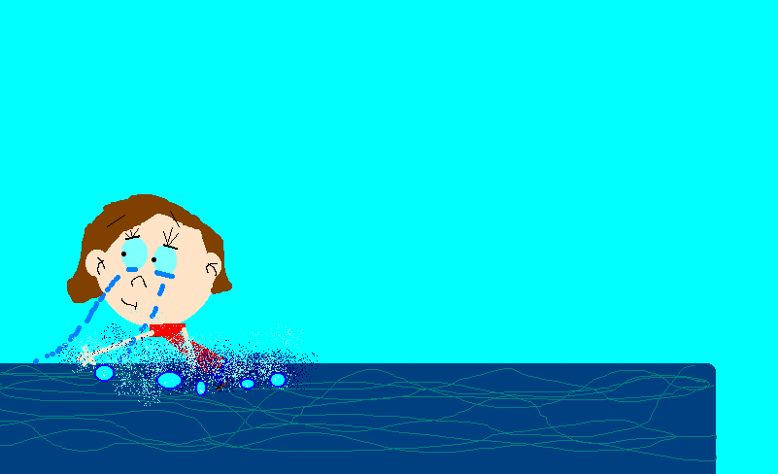

Slide 58
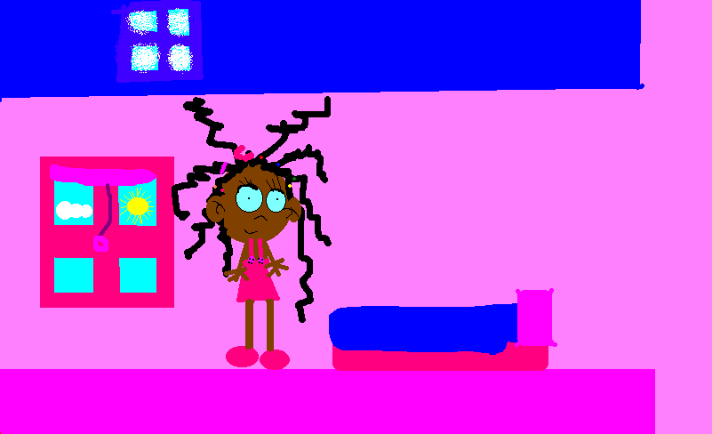

Slide 59
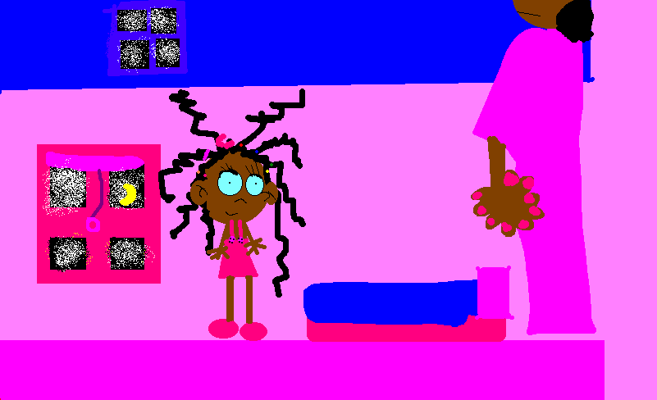

Slide 60
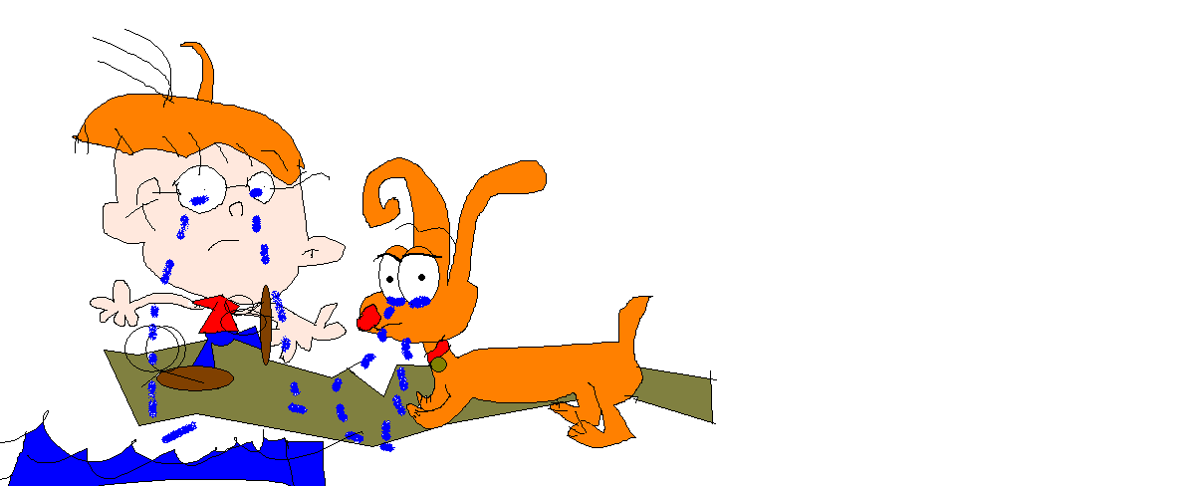

Slide 61
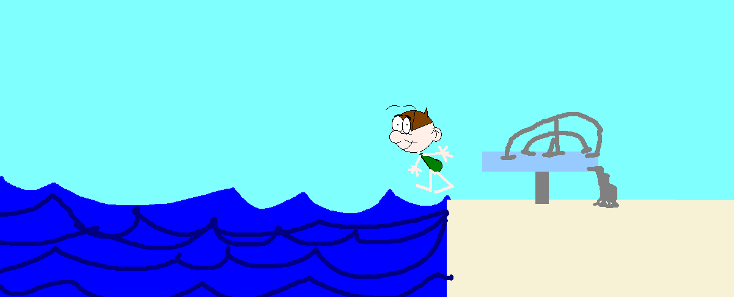

Slide 62
Resources
http://www.autismspeaks.org/what-autism/treatment/treatment-associated-psychiatric-conditions
http://card-usf.fmhi.usf.edu/docs/resources/CARD_ASDMH_Brochure092109.pdf
Lindgren, S. & Doobay, A. (2011). Evidence-based interventions for autism spectrum disorders. Iowa City, Iowa: University of Iowa Children’s Hospital, Center for Disabilities and Development.

